Slide 1
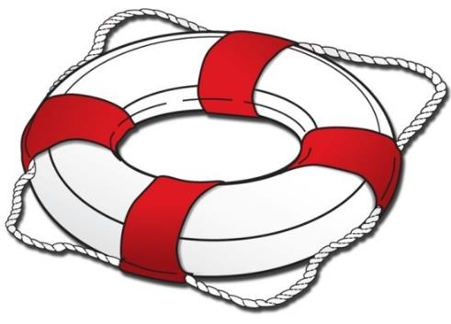
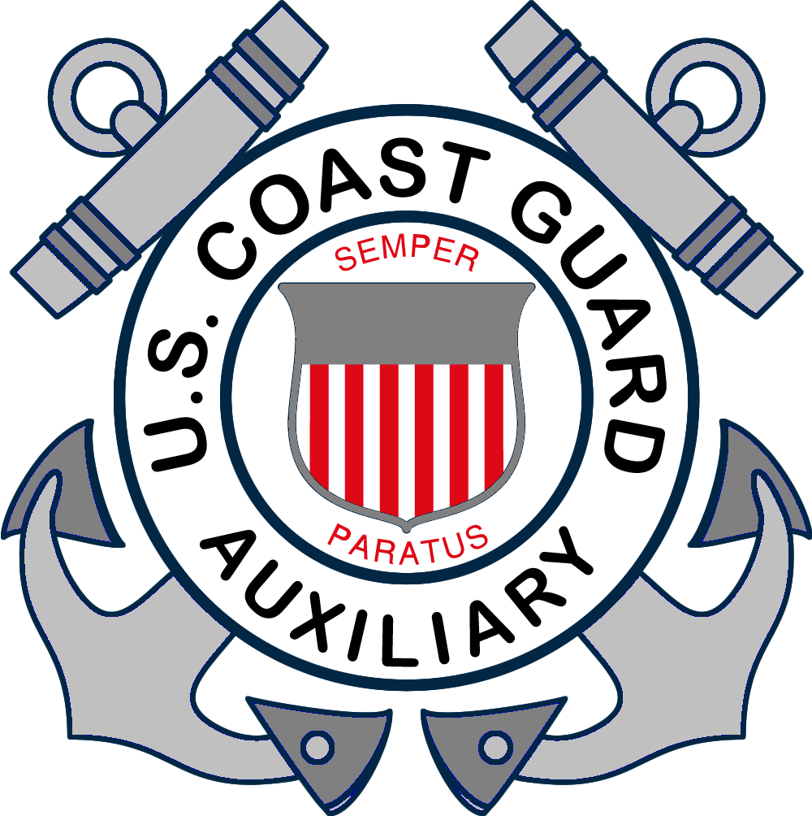
Chapter 4
The Legal Requirements of Boating
Notes:
Classroom aid: This entire chapter can be done out of doors without PowerPoints.
Have a flotilla member trailer a boat to the class; hand out VSC form 7012s to each student, and have them take turns asking the boat “owner” for each item. The Instructor can facilitate this discussion by making sure pertinent points are all covered
A second option is to bring a selection of required safety equipment into the classroom, break the students into groups, and assign each a “boat” of 21’ (A table works nicely). Have each group decide on the appropriate gear for the boat.
The Coast Guard has responsibility for federal laws, equipment and requirements
The states may have additional requirements
The boat operator must be aware of and comply with all federal and state requirements
Anyone renting a boat is responsible to make sure all the required equipment is aboard!
The items in this chapter are legally required but is only PART of what you need for a safe and enjoyable boating experience!

Slide 2
Key Topics
Numbering and Documentation
Hull Identification Number
Age and Education Requirements
Unlawful Operation
Alcohol and Drugs
Obstructing Navigation

Slide 3
Key Topics
Homeland Security
Personal Flotation Devices
Fire Extinguishers
Flame Arrestors, Ventilation, and Mufflers
Navigation Lights
Visual Distress Signals
Sound-Producing Devices

Slide 4
Key Topics
Other Equipment and Regulations
Personal Watercraft Laws
Laws Relating to Towing Persons
Waste, Oil, and Trash Disposal
Protecting the Environment
Reporting Accidents
Enforcement

Slide 5
Objectives
You should be able to…
Tell which vessels need to be registered and how to do so.
Place certificate numbers and validation decals on a vessel correctly.
Find the hull identification number (HIN) on a vessel.
Explain the age and education restrictions on vessel or personal watercraft (PWC) operation.

Slide 6
Objectives
List the reckless or negligent behaviors that should be avoided when operating a vessel.
Explain the dangers of consuming alcohol or drugs while boating and the penalties for doing so.
Tell the laws pertaining to obstructing navigation.
Explain your role in keeping waterways safe and secure.

Slide 7
Objectives
Identify the classifications and uses of personal flotation devices (PFDs), and state the legal requirements.
Tell the legal requirements for fire extinguishers, backfire flame arrestors, ventilation systems, and mufflers.
Tell the legal requirements for navigation lights, visual distress signals, and sound-producing devices.

Slide 8
Objectives
Tell the requirements for other equipment such as diver-down flags or state-required equipment.
List the legal requirements specific to PWC.
List the legal requirements for towing a person behind a vessel.
Explain how to dispose of waste, trash, and oil properly and how to use marine sanitation devices (MSDs) properly.
Tell when and how to report a boating accident.

Slide 9
Certificate of Number and Decal
You must have a Certificate of Number and a validation decal(s) to operate your vessel legally.
Registration card must be carried on board whenever the vessel is being operated.
Notes:
Add your state’s specific requirements here.
The original Certificate of Registration must be aboard.
Numbers/Letters are on the registration certificate
They numbers/letters must be permanently displayed on the forward half of the vessel on both the port and starboard side

Slide 10
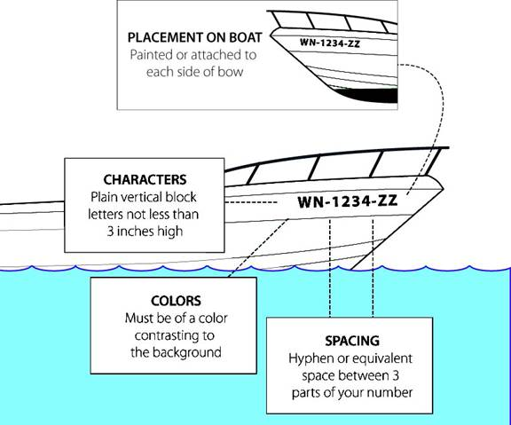
Certificate of Number and Decal
State laws vary. Check with your state’s boating agency for specific requirements.
Placement of decals
Expiration
Notes:
Add your state’s requirements here.
Discuss:
placement of numbers,
spacing of numbers/letters,
minimum height of 3”,
contrasting color to hull color
plain block letters
State Specific:
Placement of decal – port? Starboard? In front of numbers? Behind numbers? Documented boat?
Where do you register your boat in your state?
Boat is registered in state of principle use
Registration numbers must stay on boat unless state of use is changed

Slide 11
Other Facts About Titling and Registration
In your state:
Is a title required for a vessel?
Is a title required for an outboard motor?
When do the Certificate of Number and validation decal expire?
What should you do if a vessel is transferred, destroyed, abandoned, lost, stolen, or recovered?
Notes:
Add your state’s requirements here.

Slide 12
Other Facts About Titling and Registration
In your state:
What should you do if a Certificate of Number or validation decal is lost or destroyed?
What should you do if your address changes?
How do you apply for a U.S. Coast Guard “Certificate of Documentation” for a larger recreational vessel?
Notes:
Larger boats - documentation
A Coast Guard registration
Original documentation must be aboard
Boat operator still subject to state and federal requirements
Only US citizens may have a large vessel documented
Documentation numbers must be clearly visible on the interior structure
Name and hailing port at least 4” high on the hull
Add your state’s requirements here.

Slide 13
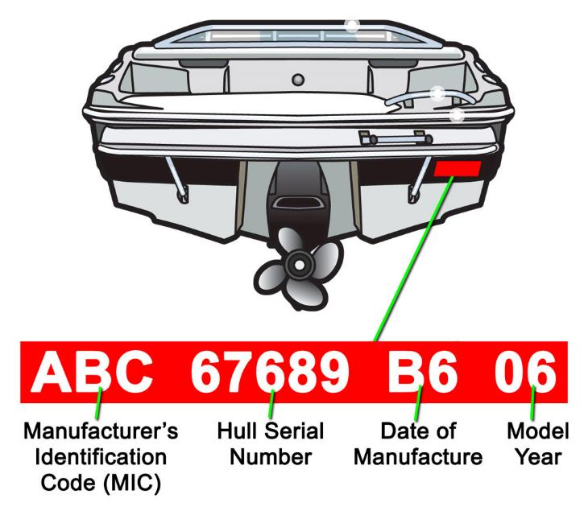
Hull Identification Number
The Hull Identification Number (HIN) is a 12-digit
number that uniquely identifies a vessel.
Notes:
ASK:
What is a HIN? Relate to an automobile’s VIN
Where is it located? Usually on the transom on the starboard size either on a permanently riveted plate or impressed into the fiberglass.

Slide 14
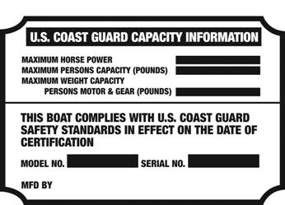
Capacity Plate/Certificate of Compliance
The Capacity Plate specifies the maximum weight and/or number of people the boat can carry safely as well as the maximum horsepower allowed for the boat.
Notes:
Federal Law mandates that all powerboats less than twenty feet in length (however, PWC and sailboat manufacturers are not required to attach a capacity plate) need to carry this information in the form of a Capacity Plate. Each Capacity Plate includes the maximum number of adult persons, the maximum gross load, and the maximum size of engine, in horsepower, that your boat can legally carry.
In many states it is a violation to exceed capacity.
Calculating Your Boat’s Capacity
On boats less than 20 feet in length with no capacity plate, use the following rule of thumb to calculate the number of persons (weighing 150 lbs. each, on average) the vessel can carry safely in good weather conditions.
Number of people = vessel length (ft.) x vessel width (ft.) ÷ 15
For example, for a vessel 18 feet long by 6 feet wide, the number of persons is 18 times 6 (or 108) divided by 15, which equals seven 150-lb. persons (or a total person weight of 7 x 150, or 1050 lbs.).

Slide 15
Who May Operate a Vessel
In your state:
How old must a person be to operate a boat, personal watercraft (PWC), or vessel with a specific horsepower?
Which persons must take a boating safety education course?
Notes:
Place your state’s requirements here.
Discuss:
YOUR state’s requirements for age of operator
Is there mandatory education?

Slide 16
Who May Operate a Vessel
In your state:
Which persons must have an adult on board the vessel?
Are operators required to carry the boater education certificate on board?
Which persons are exempt from the boating safety education course?
Notes:
Add your state’s requirements here.

Slide 17
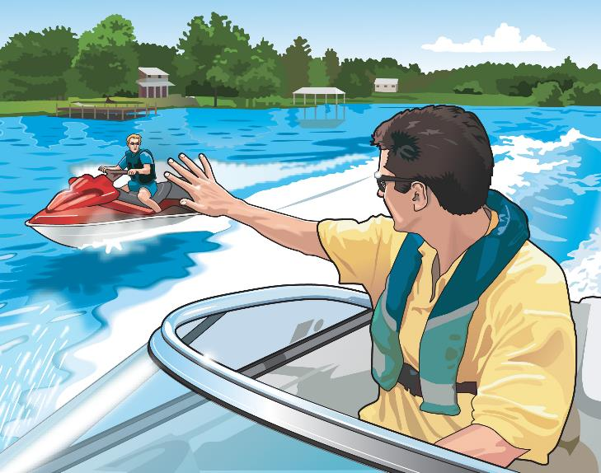
Unlawful Operation of a Vessel
Reckless operation means boating in a way that could endanger someone’s life, safety, or property.

Slide 18
Unlawful Operation of a Vessel
In your state, does operating recklessly include:
Weaving through congested traffic?
Operating in swimming areas or other restricted areas?
Jumping wakes close to another vessel?
Swerving at the last moment to avoid collision?
Chasing or harassing wildlife?
Notes:
Add your state’s requirements here.
Negligent Operation:
Operating in a restricted area
Wake jumping – hull leaves the water
Failure to regulate speed
Operating while under the influence of drugs or alcohol

Slide 19
Alcohol and Drugs
In your state:
How is boating while intoxicated (BWI) defined?
What determines if a person is intoxicated, including the blood alcohol concentration percentage?
What are the penalties for BWI?
When have you consented to be tested?
Notes:
Place your state’s requirements and BUI laws here.
Contribute to 1/3 of boating accidents
YOUR state’s regulations and penalties
The effects of alcohol and drugs
Effects made much worse by the factors involved with boating:
Noise
Sun
Vibrations
Wind and seas
Alcohol is a contributing factor in many boating accidents and deaths
If you use alcohol or drugs your chances of surviving an accident are greatly reduced
Even legal drugs may impair physical ability and judgement
BWI is a federal offense
BAC of 8%

Slide 20
Obstructing Navigation
It is illegal to:
Operate in a way that keeps other vessels from navigating safely.
Anchor in a river or channel in a place that is in the way of other vessels passing through.
Moor or attach vessel to buoy, beacon, light, or any other navigational aid.
Move, damage, or destroy any navigational aid.
Block access to a pier, wharf, boat ramp, or facility.
Notes:
It’s illegal to:
Anchor in a channel or river
Tie up to a buoy or other ATON except in an emergency
Tamper with, deface, or move any ATON
Obstruct a pier, wharf, or boat ramp
Why is this important?

Slide 21
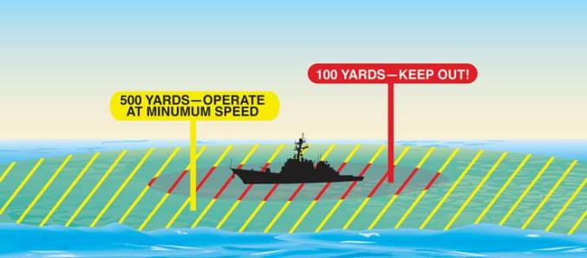
Homeland Security Restrictions
Slow to minimum speed within 500 yards of any U.S. Naval vessel. Do not approach within 100 yards.
Observe and avoid all security zones.
Observe and avoid restricted areas near dams, power plants, etc.
Do not stop or anchor beneath bridges or in channels.
Do your part to keep our waterways safe and secure.
Notes:
Stay clear of naval vessels
Be aware of security zones
No anchoring under bridges
Help with America’s Waterway Watch
Report suspicious activity to: 877-24-WATCH
Hand out the AWW decals and brochures here

Slide 22
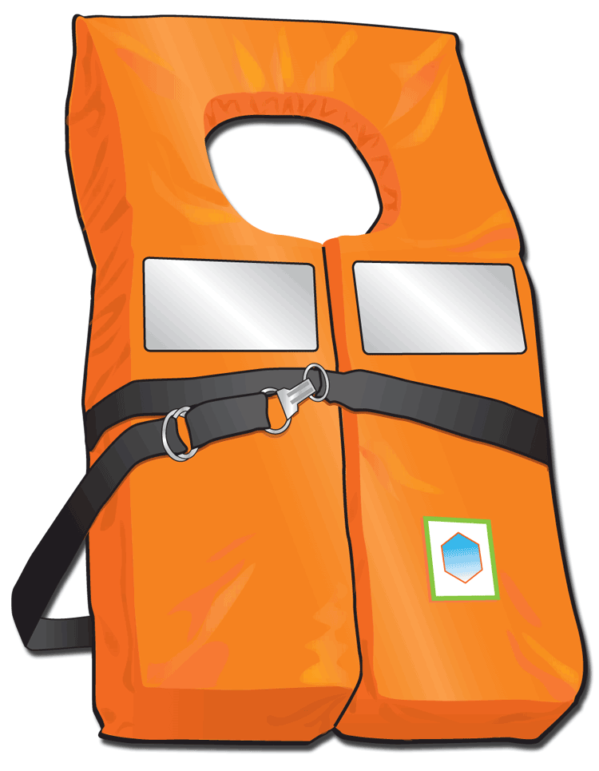
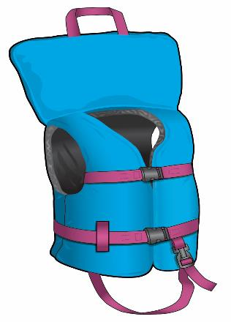
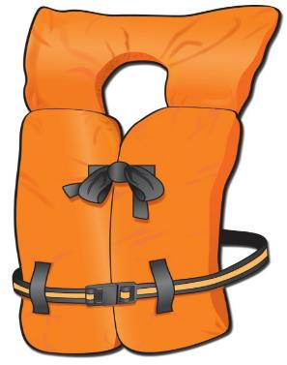
Personal Flotation Devices (PFDs)
All vessels must have one wearable USCG–approved personal flotation device (PFD), sometimes called life jacket, of a proper size for each person on board.
Type I: Wearable Offshore Life Jackets
Type II: Wearable Near-Shore Vests
Notes:
Instructor Notes:
At least one on board for each person onboard
YOUR state’s requirements for Youth
Readily accessible
Have someone define
In good condition
Must be properly fitted
Select based on use and size
Emphasize the WEARING of the PFD at all times when underway!
Inspect lifesaving equipment frequently. Do not store in original wrapping.
Explain when to discard a PFD: when it is no longer serviceable. Rips, tears, compressed flotation material, etc.
Type I: Offshore life jacket – minimum of 22 pounds buoyancy. Will turn most unconscious people face up – affords greatest protection
Type II: Near-Shore Vest – minimum of 15.5 pounds of buoyancy. Will turn most unconscious people face up

Slide 23
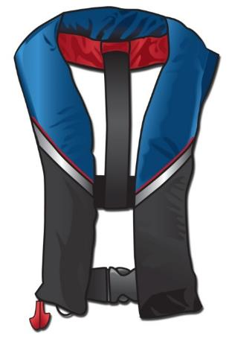
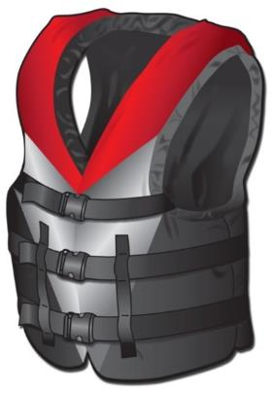
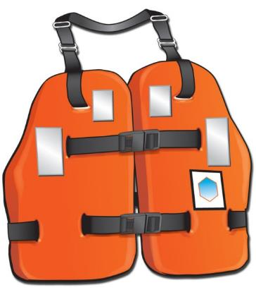
Personal Flotation Devices
Type III: Wearable Flotation Aids
Type IV: Throwable Devices
Type V: Special-Use Devices
Notes:
Classroom Aid: Bring a variety of PFDs to the class, and ask students to put them on and “model” them; have the rest of the class identify each type, it’s purpose, advantages and disadvantages.
Add the E-Directorate slides showing the new life jacket labeling system and discuss the new icon system.
Type III Flotation Aid: Minimum 15.5 pounds of buoyancy – calm, inland life jacket. Many special designs for water sports.
Type IV Throwable Device: Needed on vessels 16’ and over except canoe or kayak. Designed to be thrown, not worn. Must be immediately available
Type V: Special-Use Device: must be worn, use according to label. Our cold water survival suits (mustangs) are a good example.
Type III/V Inflatable PFD
Advantages of an inflatable
Disadvantages of an inflatable
Only for people older than 16
It must be worn

Slide 24
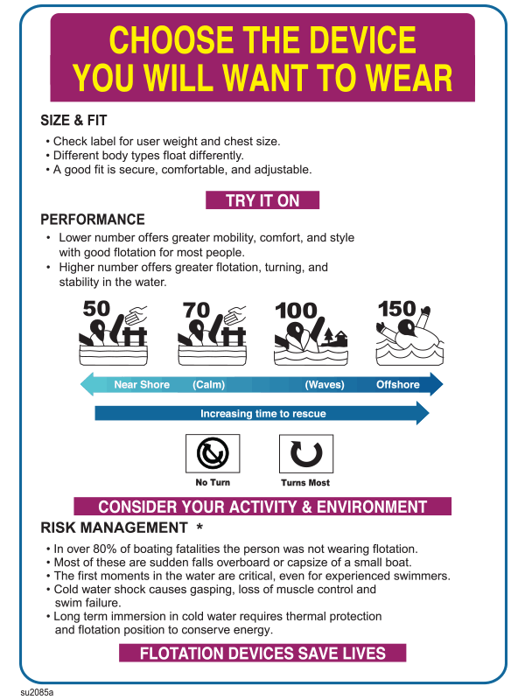
New Icons
Choose the level of buoyancy for the type of activity.
The curved arrow indicates that it is likely to turn an unconscious wearer face up in the water.

Slide 25
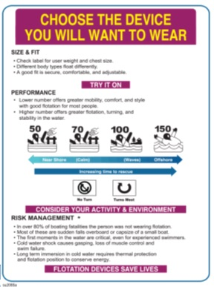
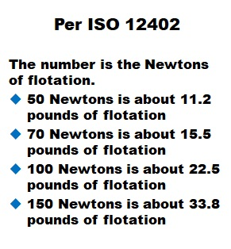
New Icons

Slide 26
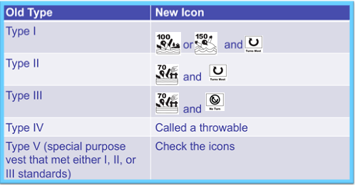
New Icons: Comparisons

Slide 27
Personal Flotation Devices
In your state:
What are the laws regarding PFDs?
What types must be carried on board?
Which vessels must have a Type IV throwable device on board?
Notes:
Review your state’s requirements here. Include minimum ages for children to wear life jackets.
If there is a difference between state and federal laws, explain the difference and when and where they come into effect.

Slide 28
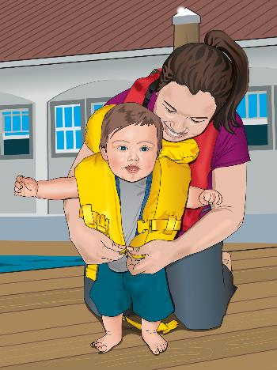
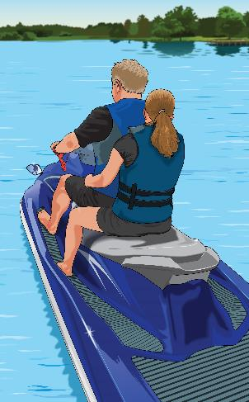
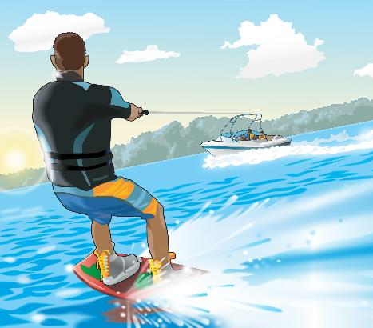
Personal Flotation Devices
In your state:
What are the PFD requirements in these situations?
Children
People on PWC
People being towed
Notes:
Add your state’s requirements.

Slide 29
Recreational Boat Cutoff Switch
Effective April 1, 2021
Recreational Boat Engine Cutoff Switch Requirements
Congress passed two laws:
Manufacturers to install engine cut-off switches on recreational vessels
Recreational vessel operators use the engine cut-off switch
Designed to reduce potential of propeller
injuries from runaway boats
Notes:
Over the last three years (2018-2020), Congress has passed two laws requiring, first, that manufacturers install engine cut-off switches on recreational vessels and, second, that recreational vessel operators use those engine cut-off switches. The laws that have placed these requirements on recreational vessel manufacturers and recreational vessel operators are found in United States Code (USC), as opposed to the Code of Federal Regulations (CFR) where these types of requirements are typically found. These are federal laws and not enforceable by state and local marine officers at this time. These new laws will improve safety for all recreational boaters by reducing the potential for propeller injuries to recreational vessel operators, other users of the nation’s waterways, and marine law enforcement officers responsible for responding to runaway boats.

Slide 30
Recreational Boat Cutoff Switch
Effective April 1, 2021
Recreational Boat Engine Cutoff Switch Requirements
Applies to recreational vessels under 26’ capable of 115 pounds of thrust (approx. 3 HP).
Act requires manufacturer, distributor or dealer of those vessels or motors to equip them with the ECOS.
Notes:
More specifically, Section 503 of the LoBiondo Coast Guard Authorization Act of 2018 created 46 USC 4312 to require a manufacturer, distributor, or dealer that installs propulsion machinery and associated starting controls on a covered recreational vessel (less than 26 feet long and capable of 115 pounds of static thrust) to equip the vessel with an ECOS per compliant with ABYC Standard A-33. This law went into effect on December 4, 2019 one year after the 2018 CGAA was enacted and is referred to as the “installation requirement.”

Slide 31
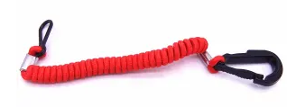
Recreational Boat Cutoff Switch
Effective April 1, 2021
Recreational Boat Engine Cutoff Switch
Operator of a vessel covered by new law
MUST USE the ECOS, except:
If main helm is in enclosed cabin
If vessel doesn’t have an ECOS
If vessel doesn’t require one
Penalty for non-compliance
1st offense: $100 fine
2nd offense: $250 fine
3rd offense: $500 fine
Notes:
Section 8316 of the National Defense Authorization Act of 2021 amended 46 USC 4312 to require individuals operating those recreational vessels covered by the installation requirement to use ECOS links, except if the main helm is within an enclosed cabin or the vessel does not have and is not required to have an ECOS. It provides a penalty of $100, $250, and $500 for the first, second, and third offenses, respectively. The law goes into effect on April 1, 2021. This requirement is referred to as the “use requirement.”

Slide 32
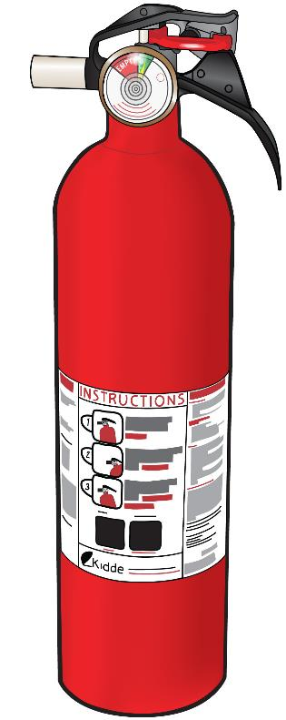
Fire Extinguishers
Classification of Fires
Type A: combustible solids like wood
Type B: flammable liquids like gasoline or oil
Type C: electrical fires
Notes:
Type A Fire: Think of A for “leaves ash”. Trash, wood, paper
Type B Fire: Think of B for “boil”. Flammable liquids like gasoline, grease, turpentine. CG type required
Type C Fire: Think of C for “current”. Electrical current
You may want to mention Type D fires too. Ask the class what is a D fire? Combustible metals? Why would we discuss that in a boating class? Are we worried about our engine catching fire and melting? No! So why? Flares. Discuss how to put them out.

Slide 33
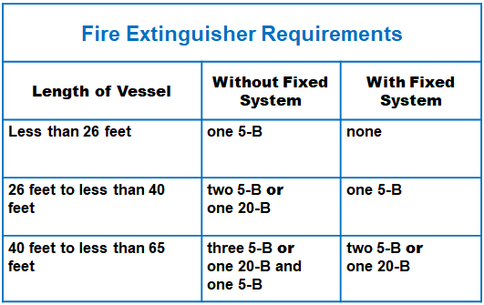
Fire Extinguishers
Notes:
These are minimum requirements
PASS Method
Pull the pin
Aim at the base of the file
Squeeze the trigger
Sweep the base of the fire
Effective August 22, 2016 the Coast Guard’s weight-based classifications were changed to adopt the UL’s (Underwriter’s Laboratory) fire performance rating classification system. The UL rating system has been in use for decades and is widely accepted and regarded as the most practical system. The former B-1 is now 5-B. The former B-II is now 20-B. Current fire extinguishers only need to be replaced with UL rated extinguishers when they are no longer serviceable.

Slide 34
Fire Extinguishers
Fire Extinguisher Expiration Dates
Effective April 20, 2022
Older than 12 years, considered expired
Manufacturer stamp on the bottom
Must be removed from service as of December 31 of the 12th year
Notes:
Fire Protection for Recreational Boats
New regulation goes into effect on 04/20/2022
Extinguishers UL Classified 5-B:C/10-B:C (or greater) meet carriage
requirements for ALL recreational vessels regardless of vessel age.
Extinguishers rated as Marine Type USCG Type B:C, size I or size II are only
acceptable on vessels built model year 2017 or earlier. Model year means the period beginning June 1 of a year and ending on July 31 of the following year and being designated by the year in which it ends.
Ratings that include higher numbers or more letters are acceptable.
One 20-B extinguisher may be carried to replace two required 5-B extinguishers.
Make sure disposable fire extinguisher is not more than 12 years old from date
stamp on bottle. Must be removed from service on 31 December of the 12th
year.
Good and serviceable working condition means:
(i) If the extinguisher has a pressure gauge reading or indicator it must be in the operable range or position;
(ii) The lock pin is firmly in place;
(iii) The discharge nozzle is clean and free of obstruction; and
(iv) The extinguisher does not show visible signs of significant corrosion or damage.

Slide 35
Fire Extinguishers

Slide 36
Fire Extinguishers
Extinguishers should be placed where they are accessible and can be reached immediately.
Check the following on a regular basis.
Seals and tamper indicators are not broken or missing.
The extinguisher is fully charged.
There is no physical damage.
In your state, are any vessels exempt from the fire extinguisher requirement?
Notes:
Fire Extinguishers should be placed anywhere they can be easily accessed in an emergency.
Care and treatment:
Check pressure
Check locking pin
Has the extinguisher been used
NEVER test fire an extinguisher
Fire Extinguishers should be placed in an accessible area—not near the engine or in a compartment, but where they can be reached immediately.
Fire extinguishers should not be stored where you cannot reach them or where they can be damaged. Fire extinguishers should be mounted in an open area, standing upright, easily accessible, and in a place where they can be inspected regularly.

Slide 37
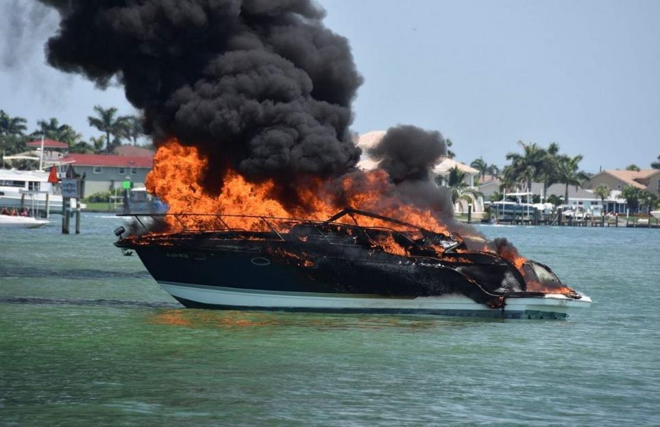
Backfire Flame Arrestors
Prevent ignition of gasoline vapors if engine backfires.
Notes:
Required for inboard carbureted enclosed gasoline engines (not outboards)
Avoids carburetor backfire
Keeps “backfire” sparks from igniting fumes
Must be Coast Guard Approved or U 1 SAE type
Must be kept clean

Slide 38
Backfire Flame Arrestors
Must be:
On each carburetor.
In good working condition.
USCG–approved.
Should be cleaned periodically and checked for damage.
Notes:
As the name suggests, the purpose of a boat backfire flame arrestor is to stop flames, which can result from an engine backfiring, from coming into contact with other fuel and starting a fire on board your boat. To do this important job, the backfire flame arrestor needs to be in good condition.
The Flame Arrestor Working Principle
All flame arrestors have the same working principle: removing heat from the flame as it attempts to travel through narrow passages with walls of metal or other heat-conductive material. ... Flame arresters are passive devices with no moving parts.

Slide 39
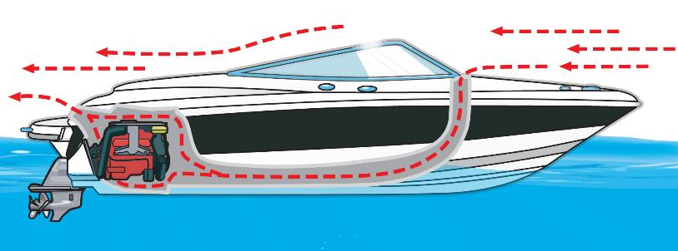
Ventilation Systems
Gasoline-powered vessels built to trap fumes must have a natural ventilation system.
If your vessel has a power ventilation system, let it run for at least four minutes before starting the engine.
Notes:
Many fires/explosions caused by gasoline fumes in enclosed engine/fuel compartments
Best detector – Your NOSE!
Don’t start the engine if YOU smell fumes!
Required on gasoline powered boats
Exhaust fumes can cause carbon monoxide poisoning – detectors are available
Natural ventilation – uses ‘ram effect’ of motion
Powered ventilation – uses blowers
Exhaust and Air supply ducts must be above the usual level of water in Bilge
Warning label:
Gas vapors can explode. Before starting engine, operate blower for four minutes and check engine compartment bilge for gas vapors.
Warning Label must be displayed near ignition switch

Slide 40
Carbon Monoxide
Odorless, colorless, and tasteless
Primary source: gasoline generators
Prevention: turn off all engines when activities are in progress at the stern of the boat
Another source is an open flame: Stoves, ovens, heaters, grills, etc.
Prevention: ensure good ventilation
Install carbon monoxide detectors
Notes:
Carbon monoxide is a potentially deadly gas produced any time a carbon-based fuel, such as gasoline, propane, charcoal or oil, burns. Sources on your boat include gasoline engines, generators, cooking ranges, and space and water heaters.
CO that builds up in the air space beneath the stern deck or on and near the swim deck can kill someone in seconds. Traveling at slow speeds or idling in the water can cause CO to build up in a boat's cabin, cockpit, bridge, and aft deck, or in an open area.
The "station wagon effect," or backdrafting can cause carbon monoxide to accumulate inside the cabin, cockpit and bridge when operating the boat at a high bow angle, with improper or heavy loading or if there is an opening which draws in exhaust. This effect can also cause carbon monoxide to accumulate inside the cabin, cockpit, aft deck, and bridge when protective coverings are used and the boat is underway.
carbon monoxide can quickly build to dangerous levels. When there's too much carbon monoxide in the air, it can enter your bloodstream through your lungs. Once in your bloodstream, it replaces the oxygen you need to stay alive.
To protect yourself and others against CO poisoning while boating: Allow fresh air to circulate throughout the pleasure craft at all times, even during bad weather.

Slide 41
Mufflers and Noise Level Limits
In your state:
What type of muffling system is required?
What are the noise level limits?
What modifications are prohibited?
Notes:
Add your state’s muffler requirements here.
Powerboats use marine mufflers, commonly made out of non-metallic materials, to contain engine noise and cool the exhaust. Mufflers are always mounted above the waterline, and usually have some sort of check valve in-line to prevent backwards water flow, which might damage the engine.
Many states has requirements similar to these: boats must not exceed a noise level of 90 dBA when stationary at ilde and measured from a distance of 3 feet, and; all motorboats must not exceed a noise level of 86 dBA when measured from a distance of 50 feet.

Slide 42
Navigation Lights
Vessel must be equipped with proper navigation lights.
Lights must be used:
Between sunset and sunrise
When visibility is limited
Notes:
What are your state’s requirements?
Between sunset and sunrise
Restricted visibility
Fog, snow, ice, heavy rain
Sailboats under power are power-driven
Review light colors
Port=left has four letters, port is four letters, and port wine is red
Starboard=greeen

Slide 43
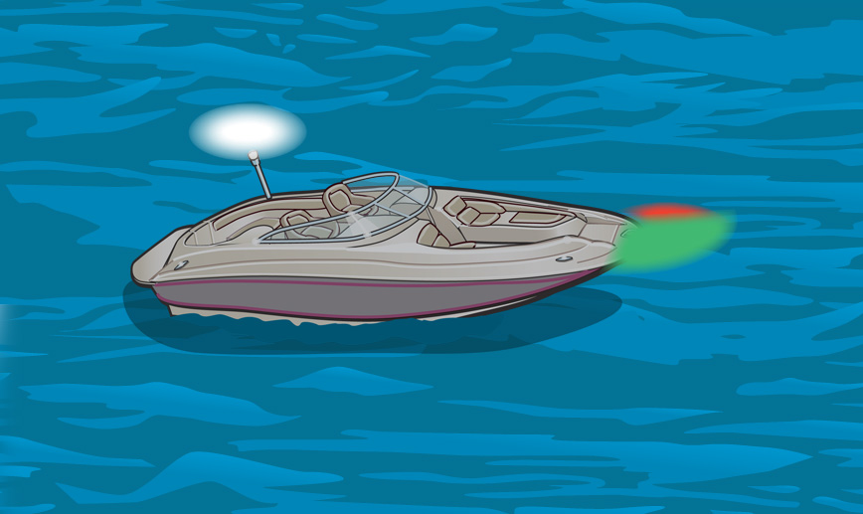
Navigation Lights
Power-Driven Vessels Less Than 39.4 Feet
Notes:
What are your state’s requirements?

Slide 44
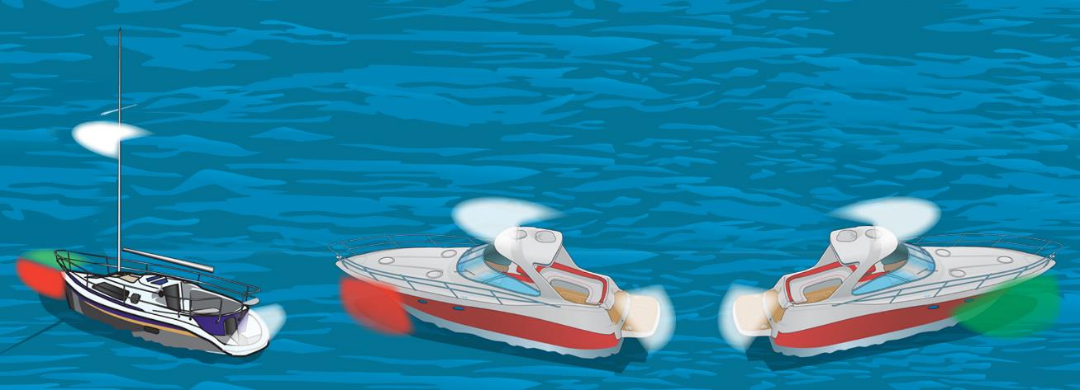
Navigation Lights
Power-Driven Vessels Less Than 65.6 Feet
Notes:
What are your state’s requirements?

Slide 45
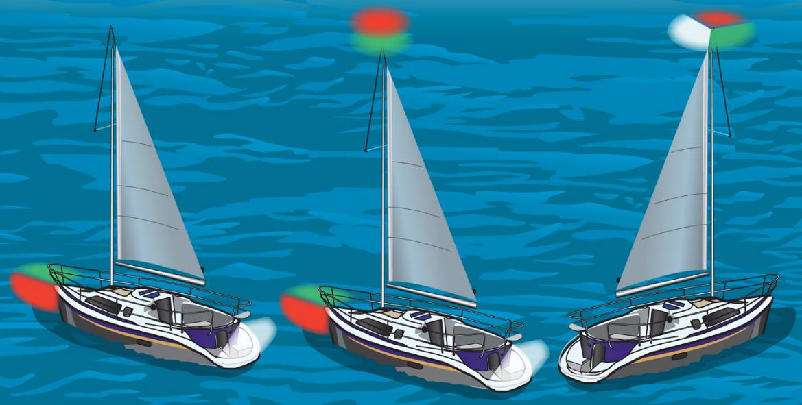
Navigation Lights
Unpowered Vessels Less Than 65.6 Feet
Notes:
What are your state’s requirements?
Remember, masthead light = under power for a sailboat

Slide 46
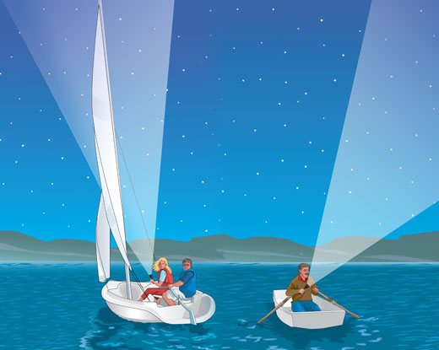
Navigation Lights
Unpowered Vessels Less Than 23 Feet
Notes:
What are your state’s requirements?
Applies to sailboats and vessels under oars less than 23’

Slide 47
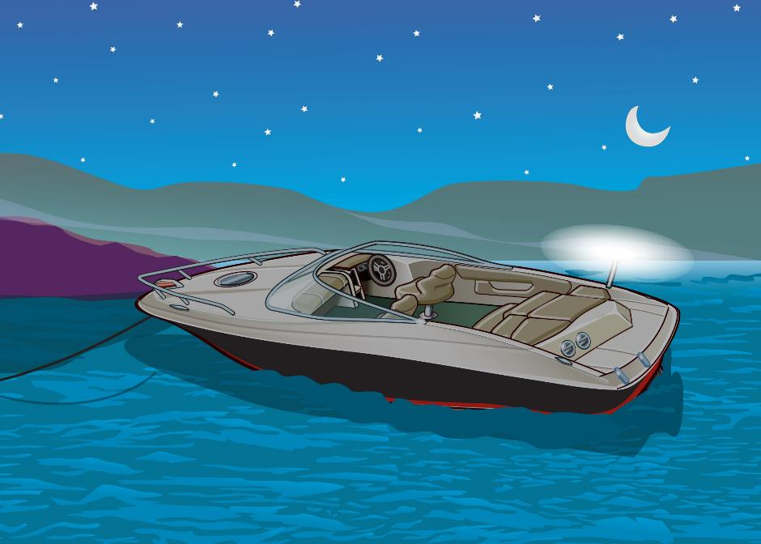
Navigation Lights
All Vessels When Not Underway
Notes:
What are your state’s requirements?
Underway= not at anchor, not aground, or not tied to a dock or pier
Not underway – 360 degree, all around white light. Make sure the running/side lights are not on.

Slide 48
Visual Distress Signals
Visual distress signals (VDSs) are classified as:
Day signals
Night signals
Both day and night signals
VDSs are either:
Pyrotechnic
Non-pyrotechnic
Notes:
A Visual Distress Signal (VDS) is any device you can use to help others locate your boat quickly in the case of an emergency. Visual distress signals include day signals that are visible in sunlight, night signals that are visible in the dark, and anytime signals that can be used both day and night.
Pyrotechnic: 3 good for night and day
Non-pyro: electric SOS light and 3 day (smoke)
All boats on coastal waters or operating at night
Flares must be under 42 months of age (measured from date of manufacture)

Slide 49
Visual Distress Signals
Vessels on federally controlled waters must carry USCG–approved VDSs.
All vessels must carry night signals when operating at night.
Most vessels must carry day signals also.
Notes:
The Regulations
The requirement to carry visual distress signals requires all boats when used on coastal waters, which includes the Great Lakes, the territorial seas and those waters directly connected to the Great Lakes and the territorial seas, up to a point where the waters are less than two miles wide, and boats owned in the United States when operating on the high seas to be equipped with visual distress signals.
The only exceptions are during daytime (sunrise to sunset) for:
Recreational boats less than 16 feet in length
Boats participating in organized events such as races, regattas or marine parades
Open sailboats not equipped with propulsion machinery and less than 26 feet in length
Manually propelled boats
These boats only need to carry night signals when used on these waters at night.

Slide 50
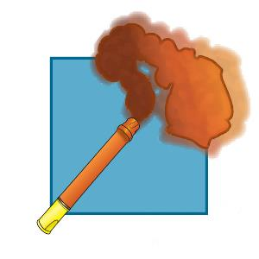
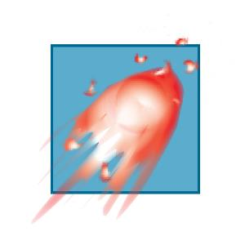
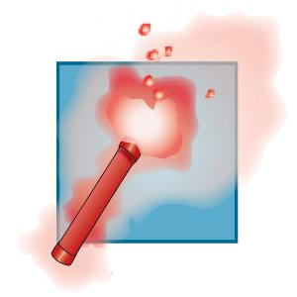
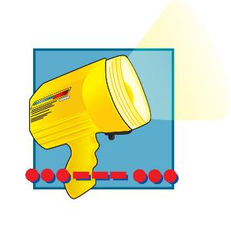
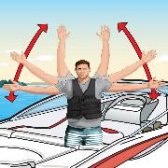
Visual Distress Signals
Pyrotechnic VDSs
Non-Pyrotechnic VDSs
Orange Smoke Day Signal | Red Meteor Day & Night Signal | Red Flare Day & Night Signal
Electric Light Night Signal | Orange Flag Day Signal | Arm Signal
Notes:
What are your state’s requirements?
While the arm signal is not USCG approved, use it if you have no other VDS aboard
USCG Approved Pyrotechnic Visual Distress Signals and Associated Devices include:
Pyrotechnic red flares, hand held or aerial
Pyrotechnic orange smoke, hand held or floating
Launchers for aerial red meteors or parachute flares
Non-pyrotechnic Visual Distress Signaling Devices
Must carry the manufacturer's certification that they meet Coast Guard requirements. They must be in serviceable condition and stowed to be readily accessible. This group includes:
Orange distress flag
Electric distress light
SOS Distress Light
The SOS Distress Light is an LED Visual Distress Signal Device that meets U.S. Coast Guard requirements to completely replace traditional pyrotechnic flares. Unlike traditional flares, this electronic flare never expires, which solves the challenge of flare disposal. The LED light flashes up to 60 hours, unlike traditional flares that last minutes or less. It flashes only the SOS sequence, per USCG requirements, and is visible up to 10 nautical miles.

Slide 51
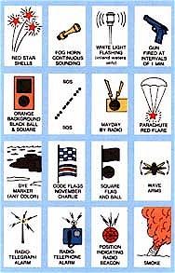
Visual Distress Signals
If pyrotechnic VDSs are used:
You must carry a minimum of three on board.
They must be dated. Expired VDSs may be carried on board, but a minimum of three unexpired VDSs must be carried in the vessel.
Notes:
Pyrotechnics must be USCG approved
Day – Night
Pyrotechnic – Non-pyrotechnic
Coastal waters – Inland waters
Do not use 12 gauge type of VDS on inland lakes due to fire danger if they come down on shore. Sky blazer hand held flares meet all day and night requirements and are relatively inexpensive.
Do not shoot them off until you see a potential rescuer.
All VDS are only good for 42 months from the date of manufacture so pay attention to the expiration dates.
Pyrotechnic: 3 good for night and day
Non-pyro: electric SOS light and 3 day (smoke)
All boats on coastal waters or operating at night

Slide 52
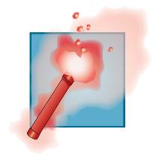
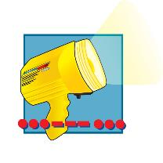
Visual Distress Signals
Example Combinations
3 handheld red flares
1 handheld red flare
2 red meteors
3 orange smoke signals
1 electric light
Notes:
Discuss whether or not you need to carry VDSs if boating on inland water less than 2 miles wide.
Daytime
Smoke
Dye/ribbon
Night time
Hand held flares
Aerial flares
Remember
Keep dry
May not work if wet
Short burn time
Use only when they might be seen

Slide 53
Visual Distress Signals
Notes:
Discuss new electronic flares and advantages over traditional flares.

Slide 54
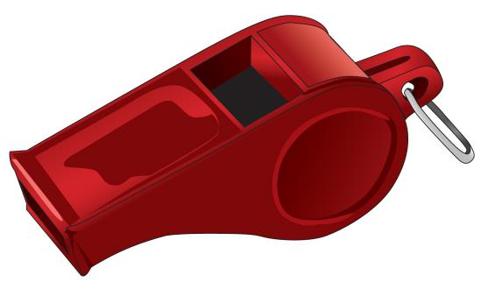
Sound-Producing Devices
Are essential when visibility is limited.
Let other boaters know what you plan to do.
Notes:
All vessels must have a way to make sound signals

Slide 55
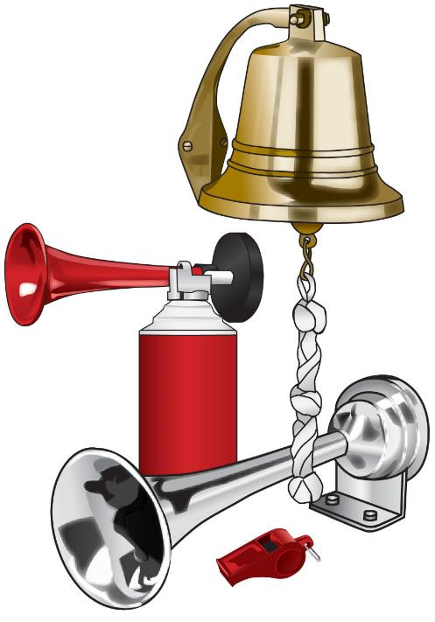
Sound-Producing Devices
Types of Sound-Producing Devices
Whistle
Horn
Bell
Notes:
Whistle or horn must be audible ½ mile
Installed power horns
Portable air horns
Whistle
Hailer
Bell
Vessels over 65.6 feet
Inland rules only

Slide 56
Sound-Producing Devices
Requirements for federally controlled waters:
Vessels less than 65.6 feet must carry a whistle, horn, or other effective sound signal device.
Vessels 65.6 feet or longer must carry a whistle or a horn, and a bell.

Slide 57
Sound-Producing Devices
In your state:
Are sound-producing devices required on your state’s waters?
What types of devices are required based on the length of the vessel?
How far away must the sound signal be audible?
Notes:
Add any state requirements here.
All vessels are required to carry an efficient sound-producing device, such as a whistle or horn, that is audible for at least one-half mile.
The sound-producing device may be a whistle, horn, or bell that is audible for one-half mile. The device must be readily accessible to the operator of the boat or the passengers.
Needed for maneuvering signals, reduced visibility, danger signal

Slide 58
Other Equipment and Regulations
Two types of flags may be used to indicate diving activity:
What flags are required in your state?
How far must a vessel stay from a diver-down flag?
Divers Flag
red-and-white
Alfa Flag
blue-and-white
Notes:
Discuss your state’s restrictions and laws regarding boating near diver flags. How far away must you stay from a diver down flag?
International Rules- rigid “Alpha” flag
State or local may require red/white diagonal
Avoid areas with boating traffic
Avoid narrow waterways
A diver down flag, or scuba flag, is a flag used on the water to indicate that there is a diver below. ... Internationally, the code flag alfa/alpha, which is white and blue, is used to signal that the vessel has a diver down and other vessels should keep well clear at slow speed.
Two types of flags are used to indicate diving activity. A rectangular red flag, at least 12 inches x 16 inches, with a two-inch, white diagonal stripe if on state waters. A blue and white International Code Flag A (or Alfa flag) if on federally controlled or international waters.
Local laws regulate how close you have to stay to your flag. and how far boaters and skiers must stay- away. For areas where no laws stipulate these distances, the rule of thumb is for you to stay within 50 feet of your flag and for boats to stay at least 100 to 200 feet away.

Slide 59
Other Equipment and Regulations
In your state:
Are permits required for marine events?
Are you required to license and/or register your vessel’s trailer?
Are you required to have certain equipment on your trailer?
Is any other equipment required?
What are the local regulations for specific waterways?
Notes:
Review your state regulations in these areas.
Know your state’s requirements
This is a good time to hand out your state’s boating law handbook and any local regulations that may apply.

Slide 60
Requirements Specific to PWC
In your state:
What are the requirements for PFDs?
Are you required to have a lanyard-type engine cut-off switch? What about a self-circling feature?
During what hours may you operate a PWC legally?
What are the age restrictions for operating a PWC?
Notes:
Discuss your state’s regulations regarding PWC operations.
Are added certificates needed to operate a PWC? Age?
PFD Required – inflatables not allowed
Lanyard/kill switch required
No night operation
No wake jumping close to other vessels
Engine safety cut-out switch is a device used to stop the engine in the event of the helmsperson being thrown out of their seat. It consists of a length of cord or plastic wire connected to a kill switch on the ignition key of the PWC .Ignition cut-off device (kill switch) must be attached to the PWC operator at all times when the motor is in use. Kill switches must operate properly.

Slide 61
Requirements Specific to PWC
In your state, do illegal activities include:
Jumping another vessel’s wake?
Weaving through traffic?
Operating above “slow, no wake speed” in certain areas?
Chasing, harassing, or disturbing wildlife?
Any others?
Notes:
Add your state regulations.

Slide 62
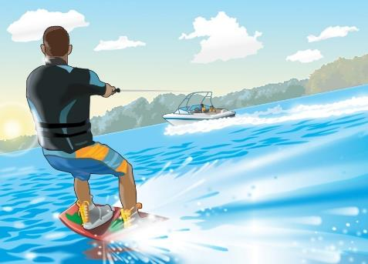
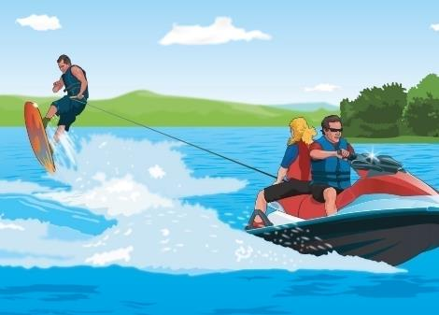
Towing a Person Legally
In your state:
What are the requirements for PFDs?
During what hours may you tow a person legally?
Are you required to have an observer on board? What about a wide-angle rearview mirror?
Notes:
Discuss your state’s regulations for towing.
PFD required for towed person
If towing from a PWC, it should be rated for at least three:
The operator
The observer
The towee for transport to and from the ski area

Slide 63
Towing a Person Legally
In your state:
What activities are illegal?
Are you required to have a skier-down flag?
Notes:
No skiing between sunset and sunrise?
Observer required?
Required to have a “skier down” flag?

Slide 64
Waste, Oil, and Trash Disposal
Discharge of Sewage and Waste
It is illegal to discharge waste, oil, or trash into any state or federally controlled waters.
Sewage carries disease.
Trash thrown into water can cause injuries.
Pollution is unsightly.
The Refuse Act prohibits throwing, discharging, or depositing any refuse matter into U.S. waters.
Notes:
Discuss:
Up to $10,000 fine
Boats 26’ and up must have pollution placard
On the water, trash can quickly become marine debris. Marine debris is any manufactured item that ends up as trash in our oceans, lakes, or inland waterways.
More than an eyesore, trash in the ocean is one of the world's most pervasive pollution problems. It sickens and kills marine animals and birds. It also undermines economies based on tourism and fisheries. While as much as 80 percent of marine debris is said to come from land-based activities, as boaters, we need to do our part.

Slide 65
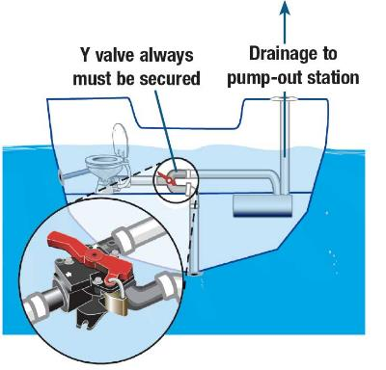
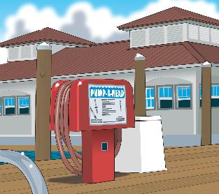
Waste, Oil, and Trash Disposal
Discharge of Sewage and Waste
Recreational vessels with an installed toilet must have a marine sanitation device (MSD).
Types I and II MSDs treat waste.
Type III MSDs do not treat waste.
Notes:
Installed toilets must be Coast Guard certified
Type I, II, or III
“Y” valve must be secured
When operating a vessel on a body of water where the discharge of treated or untreated sewage is prohibited the operator must secure the device in a manner which prevents any discharge. Some acceptable methods are: padlocking overboard discharge valves in the closed position, using non releasable wire tie to hold overboard discharge valves in the closed position, closing overboard discharge valves and removing the handle, locking the door, with padlock or keylock, to the space enclosing the toilets
Look for pump out station symbol
No sewage dumped overboard
MSD are required on installed toilets that do not have holding tanks

Slide 66
Waste, Oil, and Trash Disposal
Discharge of Sewage and Waste
Vessels 65 feet or less in length may use a Type I, II, or III MSD.
Vessels over 65 feet in length must install a Type II or III MSD.
All MSDs must have USCG certification.
Are there other requirements in your state?

Slide 67
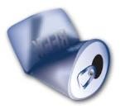
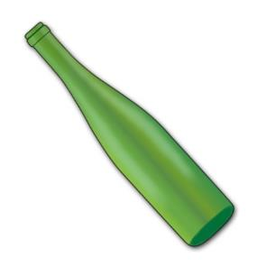
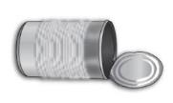
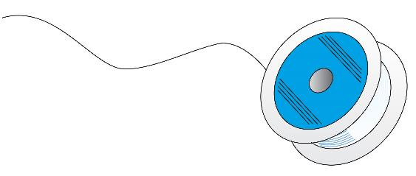
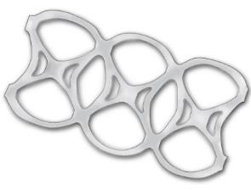
Waste, Oil, and Trash Disposal
Discharge of Trash
It is illegal to dump garbage or plastics into any state or federally controlled waters.
Many forms of litter can kill birds, fish, and marine mammals.
Notes:
No sewage dumped overboard < 3 miles
No untreated garbage dumped overboard
Garbage Record Book reqd. Boats 40ft & >
MARPOL placard reqd. boats 26ft & >
Placard summarizes MARPOL garbage requirements

Slide 68
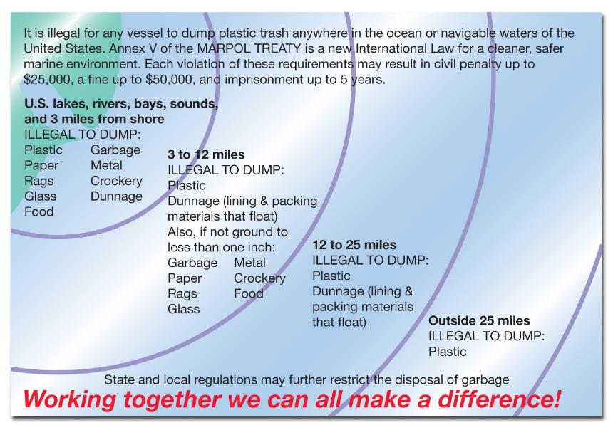
Waste, Oil, and Trash Disposal
Discharge of Trash
On federal waters, display a 4” x 9” garbage disposal placard on any vessel 26 feet or longer.
Notes:
Federal Requirements
Boats 26’ and up must display this placard
Under federal law, it is illegal to toss ANY garbage from a boat while you are anywhere in lakes, rivers, bays, sounds, and offshore in the ocean less than 3 miles.
All boats 26 ft or more in length must have a written garbage placard "prominently posted" to remind you and your crew what can be thrown overboard and what can't. The placards must be permanently attached, be made of durable material, and must be at least 4X9 inches in size. Placards can be found at your local boating retail store.
Violations may result in civil penalties up to $25,000, a fine of up to $250,000 for an individual or up to $500,000 for an organization and/or a prison sentence of up to 6 years. State anti-littering laws may also apply on your boating waters.

Slide 69
Waste, Oil, and Trash Disposal
Discharge of Oil and Other Hazardous Substances
Do not discharge hazardous substances into U.S. waters.
Do not dump oil into the bilge.
Store and dispose of oil waste properly.
Notes:
Oil Pollution Act
Discharge of Oil Placard
Up to $10,000 fine
Boats 26’ and up must have pollution placard

Slide 70
Waste, Oil, and Trash Disposal
Discharge of Oil and Other Hazardous Substances
Notify the National Response Center immediately if your vessel discharges oil or hazardous substances in water.
Call 1-800-424-8802 to notify the National Response Center.
What is the contact information in your state?

Slide 71
Waste, Oil, and Trash Disposal
Discharge of Oil and Other Hazardous Substances
On federal waters, vessels 26 feet or longer must display a 5” x 8” placard.
Notes:
Discharge of Oil Prohibited
The Federal Water Pollution Control Act prohibits the discharge of oil or oily waste upon or into any navigable waters of the United States . This prohibition includes any discharge that causes a film or discoloration of the surface of the water, or causes a sludge or emulsion beneath the surface of the water .
Violators are subject to substantial civil and/or criminal sanctions, including fines and imprisonment .

Slide 72
Waste, Oil, and Trash Disposal
Waste Management Plan
Oceangoing vessels 40 feet or longer must have written Waste Management Plan.
The plan should tell how to discharge:
Sewage and hazardous waste
Garbage and food waste
Plastics, bottles, and cans
Oil or diesel fuel
Notes:
Does this mean boats under 40’ are exempt from waste management?

Slide 73
Stop Spread of Nuisance Species
Aquatic nuisance species include zebra mussels, quagga mussels, milfoil, and hydrilla.
Introducing these species can upset the ecosystem and hurt the environment.
Notes:
What are your state’s requirements? What nuisance species are particularly a problem in your state?
Aquatic nuisance species are organisms that disrupt the ecological stability of infested inland (e.g., rivers and lakes), estuarine or marine waters. Beyond doing ecological damage, the infestation may impair the recreational, commercial and agricultural uses of the water body
Aquatic nuisance (or invasive) species (ANS) are nonindigenous species that threaten the diversity or abundance of native species or the ecological stability of infested waters, or commercial, agricultural, aquacultural or recreational activities dependent on such waters.

Slide 74
Stop Spread of Nuisance Species
Prevent spread of aquatic nuisance species:
Inspect your vessel and trailer. Remove any plants and animals.
Drain your motor, live well, and bilge on land.
Empty your bait bucket on land.
Rinse your vessel, propeller, trailer, and equipment.
Air-dry your vessel and equipment.
Stop the spread of nuisance species by following the above points.
Notes:
Here's what you can do to prevent spreading aquatic nuisance species.
Inspect your boat and trailer, removing any nuisance species (including zebra mussels and eurasian watermilfoil) you see before leaving the area.
Drain your motor, live well, and bilge on land before leaving the area.
Empty your bait bucket on land before leaving the area.
Never release live bait into a body of water or release aquatic animals from one body of water into another.
Rinse your boat, trailer, and equipment. It is best to use high-pressure, hot water. A garden hose will work if no other option is available.
Air dry your boat and equipment for as long as possible. Five days is optimal.
Flush the engine's cooling system with hot water.
Apply antifouling materials such as paint and films to boat hulls, trim tabs, water ports, transducers, and swimming platforms to discourage zebra mussel attachment.
Paddlecraft:
Inspect your paddlecraft before leaving a body of water. ...
Rinse your paddlecraft's hull and equipment before moving from one body of water to another.
Empty your bait bucket on land. ...
Use plain water or non-phosphate detergents to clean your paddlecraft. ...
Air-dry your craft and equipment for as long as possible.

Slide 75
Boating Accidents and Casualties What the Law Requires You to Do
If you are involved in a boating accident, you must:
Stop immediately and…
Assist injured persons, if it is safe to do so and…
Give your name, address, and vessel identification.
Notes:
If you are involved in a boating accident and the boat is still afloat and you are aboard, then the first thing to do is to determine whether you or anyone else needs medical attention. If anyone has fallen overboard, then you should assist the victim back onto the boat when possible.
What do you do after a boat accident?
Determine Who Needs Medical Attention. After a boating accident, your first priority should be determining who needs medical attention.
Move Out of Harm's Way.
Notify the Coast Guard or local marine authority
Exchange Information.
Document Evidence From the Scene.
If you witness a boating accident:
By law, you must stop and render whatever assistance is necessary to any person involved in a boating accident unless the action would endanger your own boat, crew, or passengers.

Slide 76
Boating Accidents and Casualties What the Law Requires You to Do
In your state:
What types of accidents must be reported?
How do you report an accident?
How soon must it be reported?
Do you report it in writing or by some other means?
To whom do you report it?
Notes:
What are your state’s reporting requirements?
Required when
A death is involved - immediately
Person missing - immediately
Injury requiring more than first aid – 48 hours
Property damage exceeds $2000 or complete loss of vessel – 10 days
Reports used for collecting statistical data
Are NOT made public

Slide 77
Boating Accidents and Casualties What the Law Requires You to Do
Sample Boating Accident Report Form
Notes:
Where and how do you report accidents in your state

Slide 78
Enforcement
Law enforcement officers have the right to stop a vessel.
Who can stop your vessel on federal waters?
Who can stop your vessel on state waters?
In your state, what must boaters do if they are signaled to stop?
Notes:
The Coast Guard does not need probable cause to stop your boat. May do so at any time for a “vessel safety check.”
Coast Guard or other marine law enforcement’s right to stop and board at any time
Vessels overloaded, without proper PFDs or other unsafe conditions may be directed to return to shore

Slide 79
Chapter 4 Review

Slide 80
Review Exercises
What is most important when selecting the right PFD
for a passenger?
Total number of passengers on board.
Color of the PFD.
Passenger’s weight and chest size.
d. Passenger’s age and gender.

Slide 81
Review Exercises
What determines how many wearable PFDs are required on board a vessel?
Total number of people on board.
Number of seats on the vessel.
Ages of the people on board.
d. Length and width of the vessel.

Slide 82
Review Exercises
Where is the best place to store a fire extinguisher on a boat?
In the engine compartment.
In a locked storage compartment.
Mounted on an accessible location.
d. Mounted in the bilge.

Slide 83
Review Exercises
What effect does alcohol have when you are operating a vessel?
Makes it easier to pay attention.
Helps you perform multiple tasks.
Helps you avoid dehydration.
d. Increases the likelihood of accidents.

Slide 84
Review Exercises
How does the effect of alcohol consumed while boating compare to the effect on land?
About the same effect whether on land or boating.
Much greater effect while boating.
Much greater effect when on land.
d. Slightly greater effect when on land.

Slide 85
Review Exercises
What is true about operating a boat while intoxicated?
It is not considered to be a major danger.
Operating under the influence usually does not carry any penalties.
An operator with a blood alcohol concentration of 0.08% or higher is considered intoxicated.
d. A person paddling a canoe is more likely to be affected than a person operating a power boat.

Slide 86
Review Exercises
A recreational vessel is approaching a U.S. Naval vessel. At what distance from the U.S. Naval vessel must the recreational vessel slow to minimum speed?
200 yards.
300 yards.
400 yards.
d. 500 yards.

Slide 87
Review Exercises
When must navigation lights be displayed?
A night when there is risk of collision.
Only when adrift at night.
From sunset to sunrise and when visibility is restricted.
d. Only when you are anchored or in fog.

Slide 88
Review Exercises
Visibility is restricted due to fog. What should the vessel operator do to avoid risk of collision?
Speed up as much as possible to go around other vessels.
Reduce speed to the minimum needed to stay on course.
Sound two long blasts with a sound-producing device.
d. Maintain the same speed until the other vessel is visible.

Slide 89
Review Exercises
What is the best way to minimize the risk of drowning while boating?
Have everyone wear an appropriate PFD at all times.
Put on your PFD after you are in the water.
Allow on board only those persons who can pass a swim test.
d. Make sure you have a lifeguard on board.

Slide 90
End Chapter 4

